Slide 1
Sensitivity, Specificity, PPV, NPV
And the matrix of confusion

Slide 2
Goals for this lecture
Understand the use of measure like Sensitivity and Specificity in validating tests/models etc
How the setting matters – screening, diagnosis, prediction,prognosis
To understand how to work out sens/spec/ppv/npv from a basic 2x2 table
To understand the interpretation and limitations of these measures
Errors in classification – in basic Epi and Machine Learning
The relationship between sens/spec and classification AUC/ROC

Slide 3
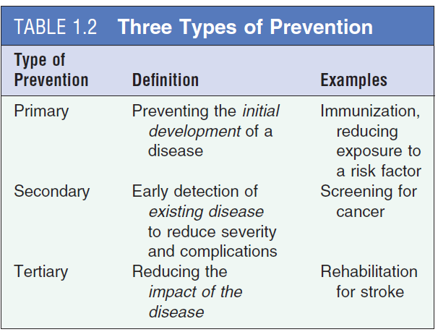
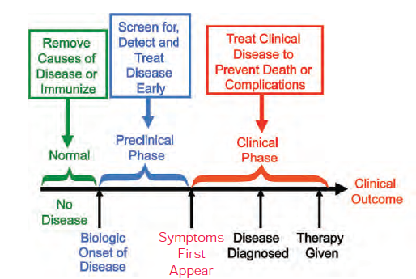
Screening
Screening is the process in which we use a test to determine whether an individual likely has a particular health indicator or not or is likely to develop a particular health indicator or not.
Screening is not the same as diagnosis; screening tests give us information about whether the disease is likely to be present
Screening can ideally detect the presence of the disease earlier so that so that early detection can improve the lives of affected by any available treatment.

Slide 4
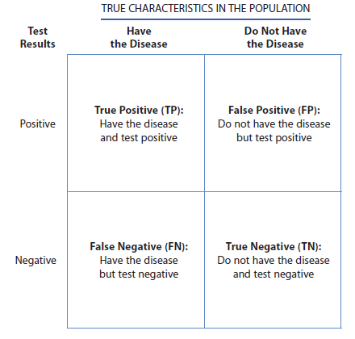
2 by 2 convention in epidemiology
2 x 2 table in epidemiology
Often called a confusion matrix
“True” characteristics of population
Convention for positive results to be in the top left corner
Screen

Slide 5
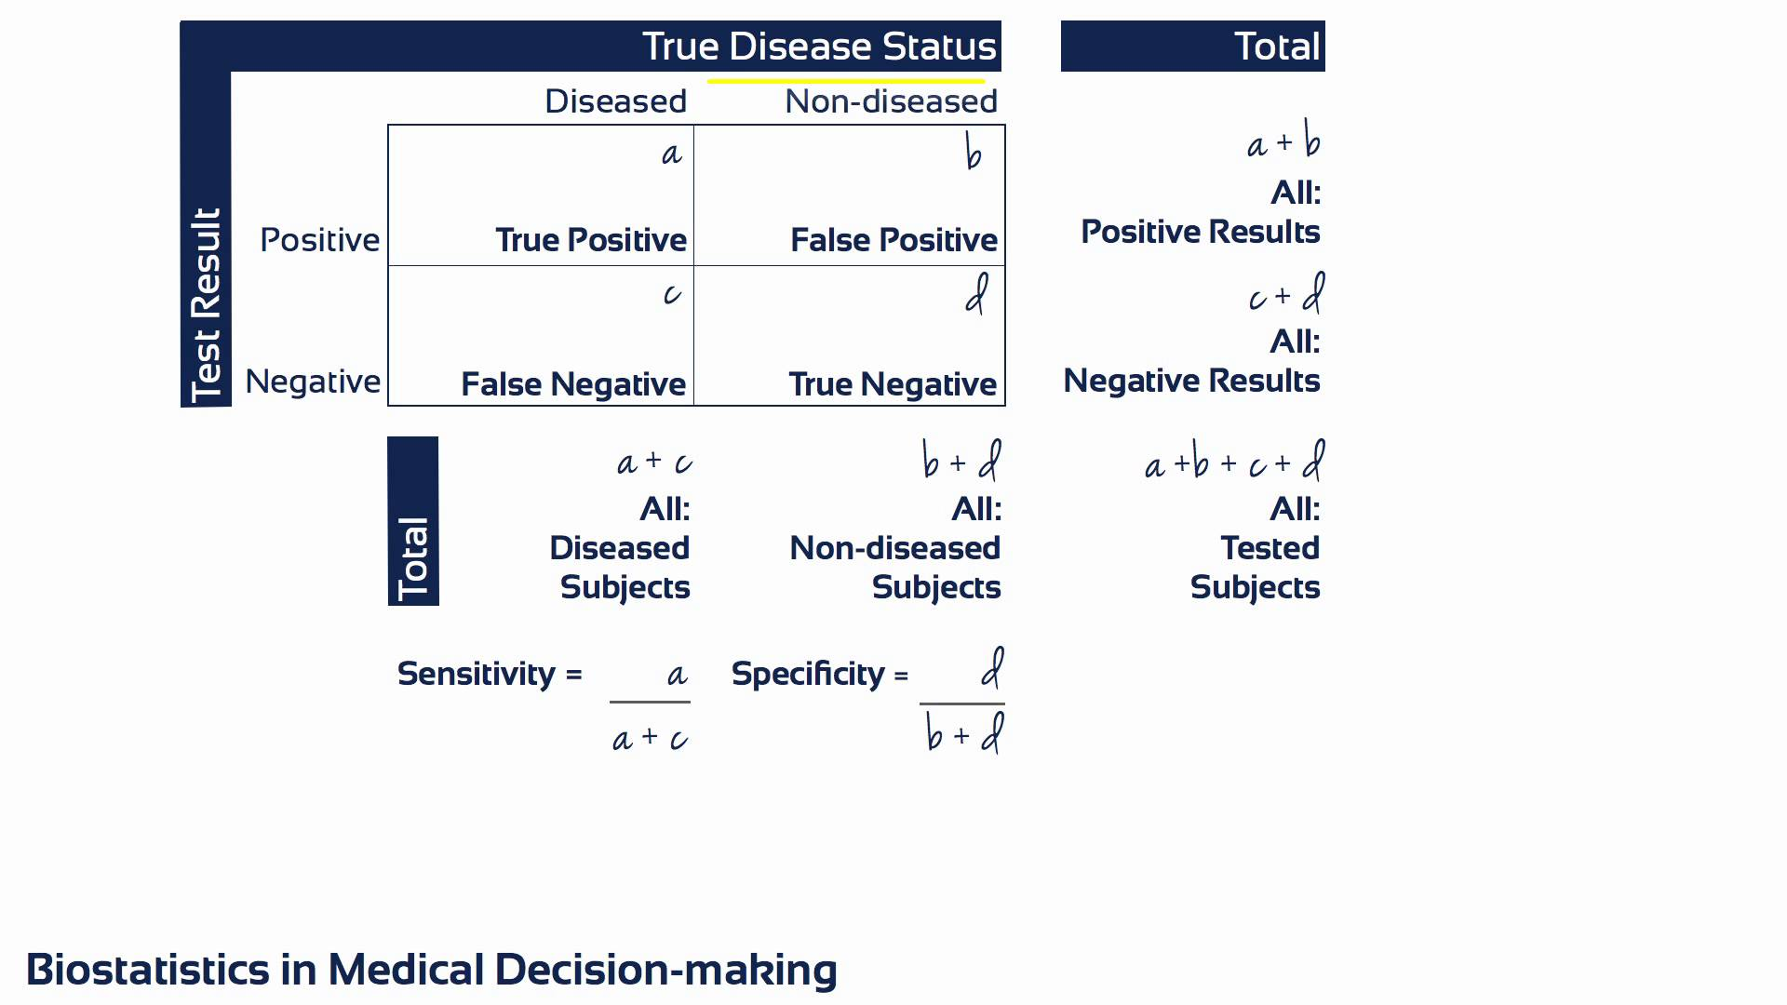
Two different perspectives: First perspective (A)
A1. Sensitivity (Se)
A2. Specificity (Sp)
B1. Positive predictive value (PPV)
B2. Negative predictive value (NPV)
Story starts from Blue. Your desire answer in Red.
Almost like inventor’s perspective.
“How well did the new screening invention
do in terms of identifying diseased and
non-diseased individuals?”
“Patient perspective.
What is the probability that I actually have
the disease when I informed that
I am screen positive?”

Slide 6
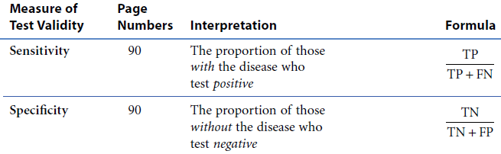


Validity of screening test (Sensitivity/Specificity)
Se $=\frac{a}{a+c}$
Sp $=\frac{d}{b+d}$
=
=

Slide 7
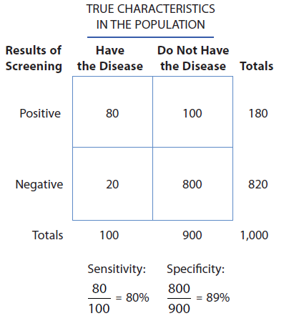
Calculation: Validity of screening test (Sensitivity/Specificity)
Sensitivity: 80/100 or 80% of diseased people were correctly identified as positive by the screening test.
Specificity: 800/900 or 89% of non-diseased people were correctly identified as negative by the screening test

Slide 8
False Negative and False Positive
False negative: 20/100 or 20% of diseased people were incorrectly classified as “disease-negative” by the screening test
False positive: 100/900 or 11% of non-diseased people were incorrectly classified as “disease-positive” by the screening test

Slide 9
Trade off between Sensitivity and Specificity
Higher sensitivity and specificity of screening tests are ideal.
Unfortunately, there is often trade off between sensitivity and specificity that can influence false positive and false positive.
So far we have discussed a test with only two possible results: positive or negative, but we often test for a continuous variable, such as blood pressure.
In the following section, we will demonstrate trade off between sensitivity and specificity for screening test that involves deciding a numeric cut-off to establish screen positive and screen negative.

Slide 10
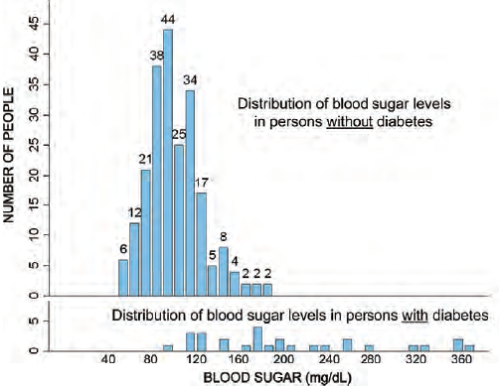
Screening test (Scenario #1): Continuous predictor for sensitivity
False Positive

Slide 11
Screening test (Scenario #2): Continuous predictor for specificity
False Negative

Slide 12
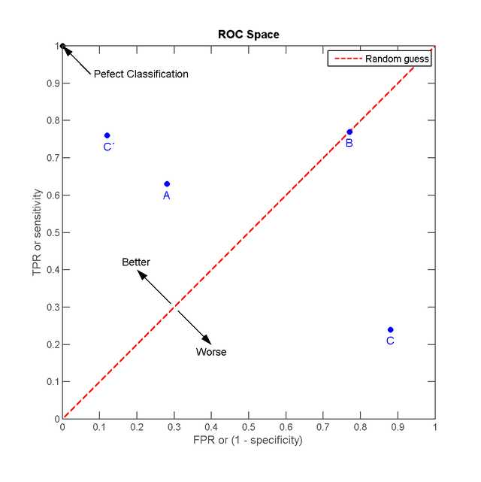
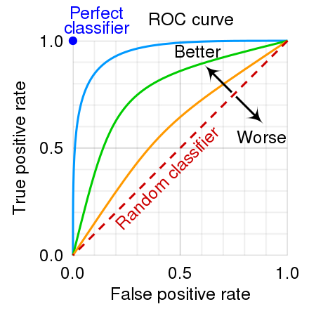
ROC Curve

Slide 13
Implications of False Positive and Negative
Choice of cut-off for screening also depends on the importance we placed on false positive and false negative.
Issues of false positive:
All people who screened positive are brought back for more sophisticated and more expensive tests.
Burden on health care system
Anxiety and emotional cost
Issues of false negative:
Treatment delay for potentially
serious nature of disease where
early intervention may be crucial.

Slide 14
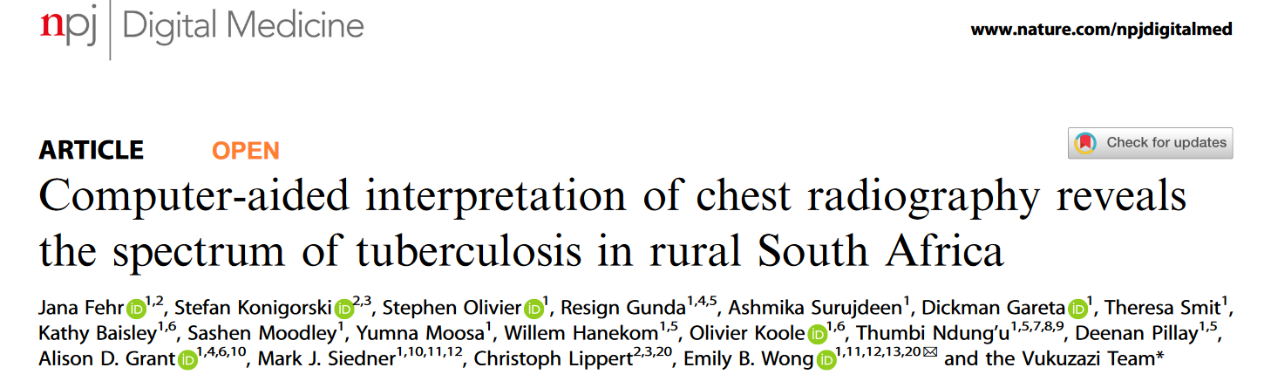
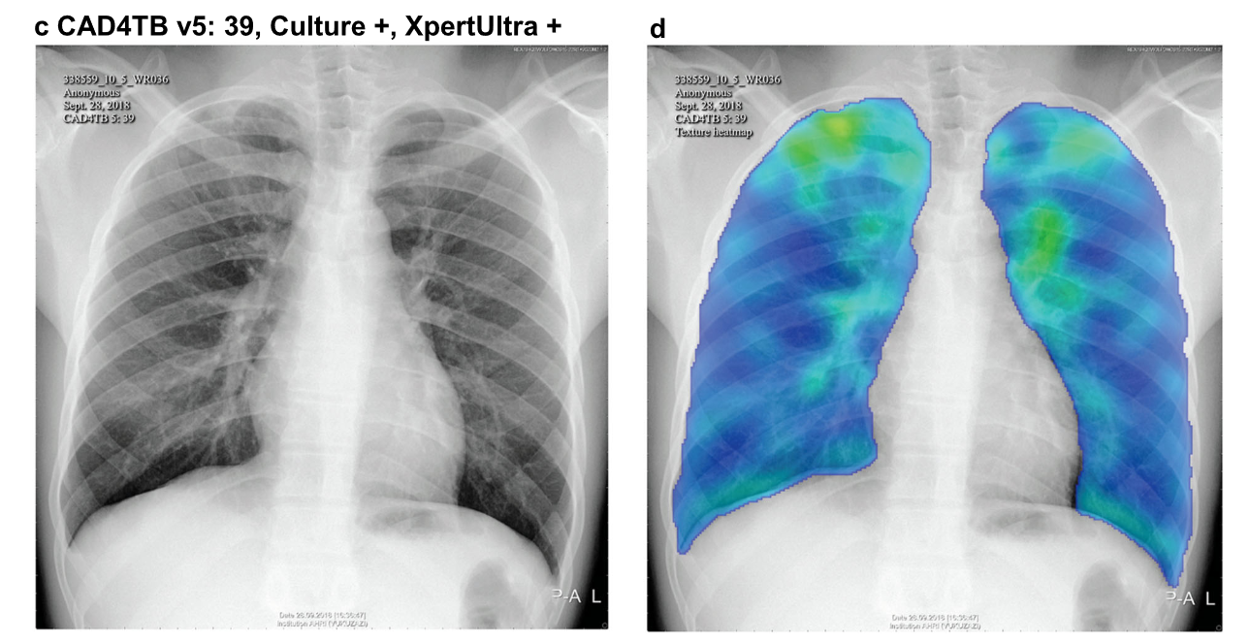
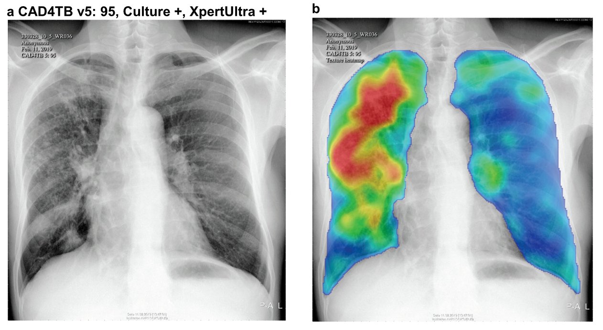

Slide 15
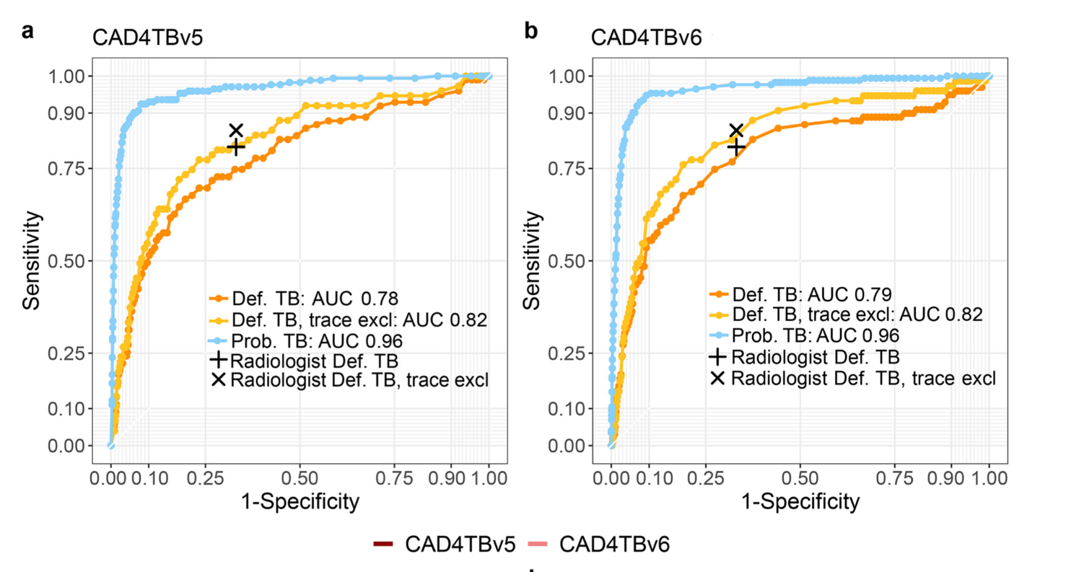

Slide 16
Two different perspectives: Second perspective (B)
A1. Sensitivity
A2. Specificity
B1. Positive predictive value (PPV)
B2. Negative predictive value (NPV)
Story starts from Blue. Your desire answer in Red.
Almost like inventor’s perspective.
How well did the new screening invention
do in terms of identifying diseased and
non-diseased individuals?
Patient perspective.
What is the probability that I actually have
the disease when I informed that
I am screen positive?

Slide 17
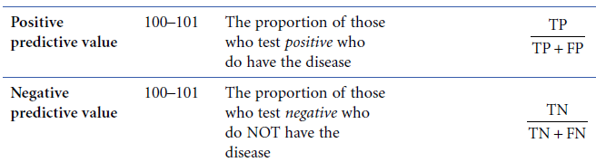


Predictability of screening test (PPV/NPV)
PPV $=\frac{a}{a+b}$
NPV $=\frac{d}{c+d}$
=
=

Slide 18
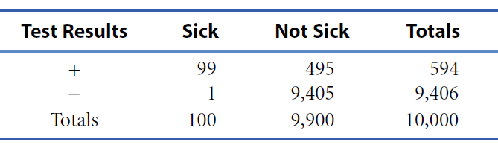
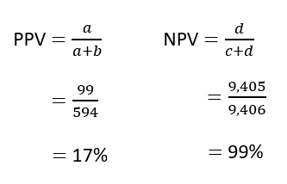
Calculation Example #1: Predictability of screening test (PPV/NPV)
PPV of 17% interpreted as – probability that you will have the disease if you test positive on screening test is 17%
NPV of 99% interpreted as – probability that you won’t have the disease if you test negative on screening test is 99%

Slide 19
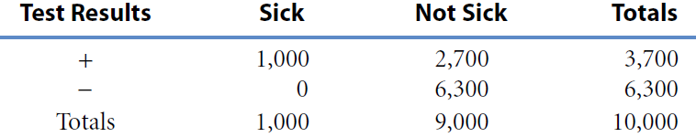
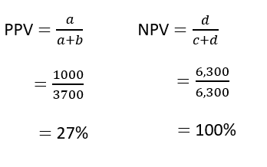
Calculation Example #2: Predictability of screening test (PPV/NPV)
PPV of 27% interpreted as – probability that you will have the disease if you test positive on screening test is 27%
NPV of 100% interpreted as – probability that you won’t have the disease if you test negative on screening test is 100%

Slide 20
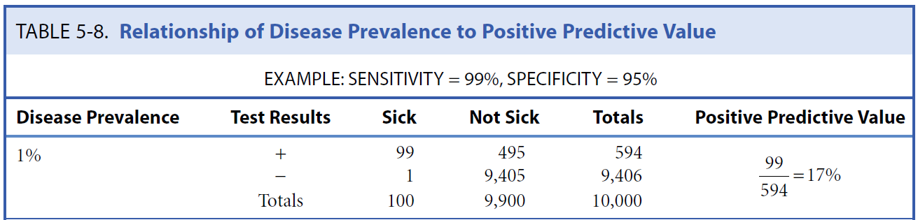

Relationship between PPV and Disease Prevalence
Point #1: PPV is influenced by prevalence of disease
Implication about targeting (e.g. where) of screening program.
Below from example #1:
Note: Virtually no changes to NPV

Slide 21
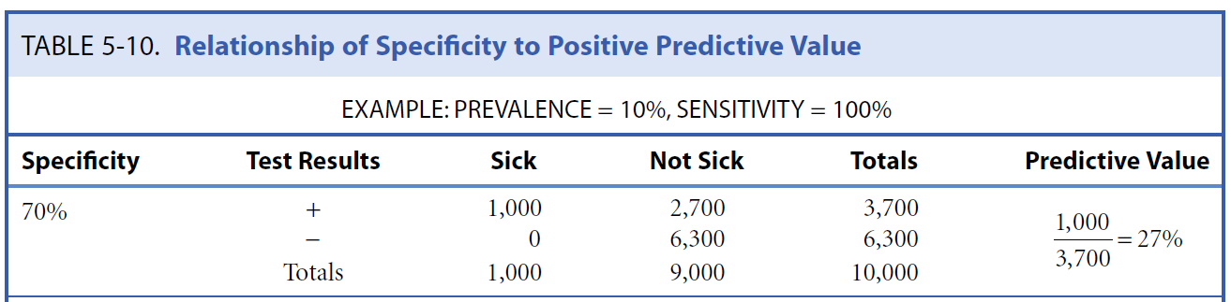
Relationship between PPV and Specificity
Point #2: PPV is influenced by specificity.
Implication about which tool to adopt for screening.
Below from example #2:
Positive
We should also care about specificity.
Note: Virtually no changes to NPV

Slide 22
Practical

Slide 23
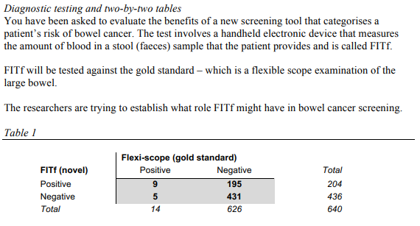
In-class exercise (project during class)

Slide 24
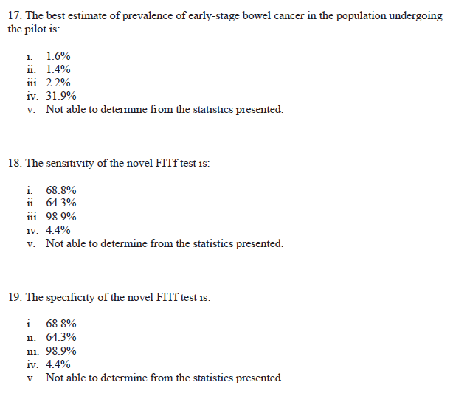
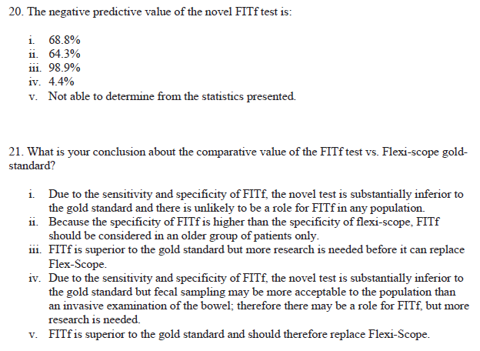

Slide 25
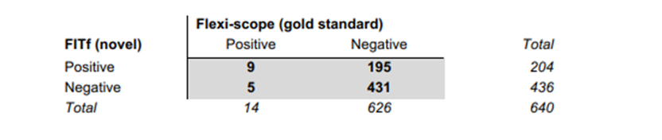
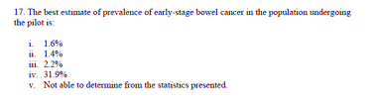
Q1 - Prevalence
PREVALENCE = (a + c)/(a+b+c+d) = 0.022 or 2.2%

Slide 26
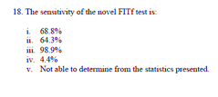
Q2 - Sensitivity
SENSITIVITY = a/(a+c) = 0.643 or 64.3%

Slide 27
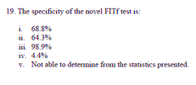
Q3 - Specificity
SPECIFICITY = d/(b+d) = 0.688 or 68.8%

Slide 28

Q4 - NPV
NPV = d/(c+d) = 0.989 or 98.9%

Slide 29
Q5 - Interpretation
Usual target value for sensitivity or specificity – 80%
FITf: Sen = 64.3%, Spec = 68.8%
Sen/Spec FITf <80%
However… Fecal blood testing – “home” testing, not invasive like biopsies, not waiting in lines for radiological exam
FITf inferior to gold standard, but approach might be acceptable in some populations. Possible role for FITf in these populations, requires more research (increase sample size?, older individuals?, individuals who are working and cannot come in for other screening tests?).

